Slide 1
Intro to Information Gathering — Passive and Active Recon

Slide 2

Information Gathering and Reconnaissance

Slide 3
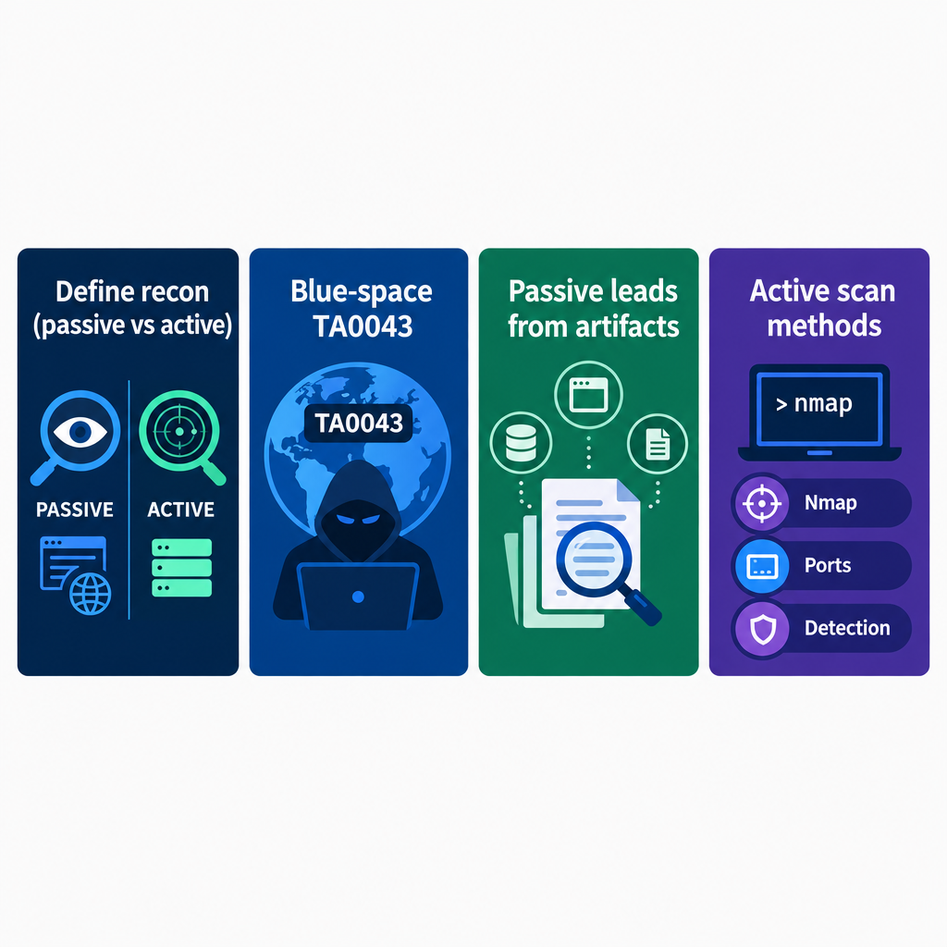
Lesson Objectives
Define reconnaissance in cyber threat hunting and counterstrike operations, and distinguish passive (observe) from active (reveal/verify).
Identify the role of recon against adversary infrastructure from blue space, mapped to ATT&CK TA0043.
Apply a short passive collection picture (artifacts, OSINT, domain pivots) to generate leads—not the primary skill this course grades.
Select and explain active scanning and enumeration methods (scan types, port states, Nmap decisions, detection trade-offs) you will use when you scan.

Slide 4
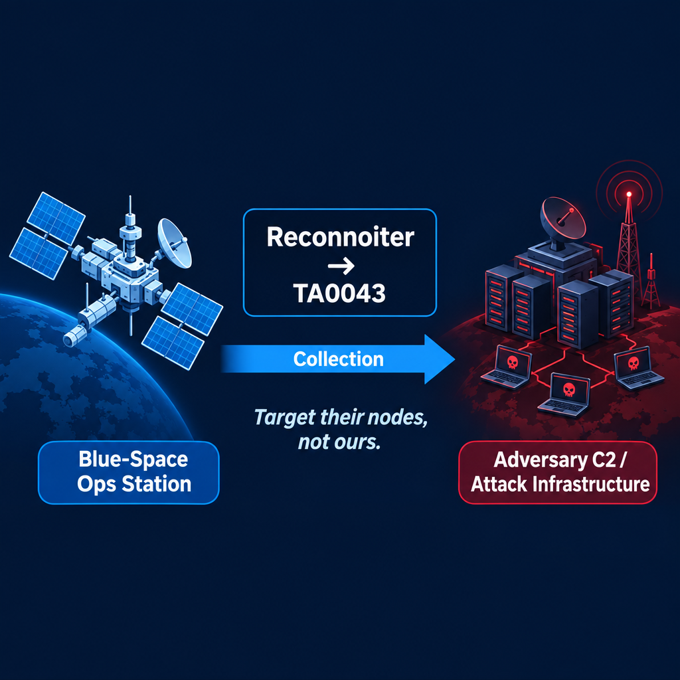
What Reconnaissance Is
Collection that produces targeting intelligence
Doctrinal task: reconnoiter
ATT&CK tactic: Reconnaissance (TA0043)
Target: adversary infrastructure, not friendly hosts
Vantage: blue space—networks you control

Slide 5
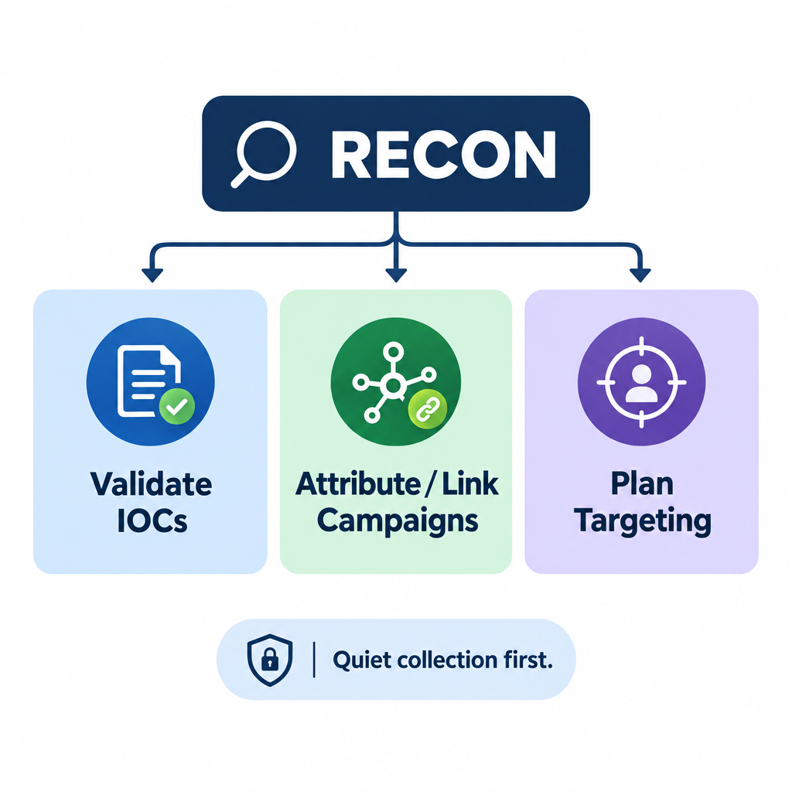
Why Collection Matters
Validate IOCs from blue-space detections
Support attribution and campaign linkage
Shape targeting and effects options
Quiet first; probe only when a decision needs it

Slide 6
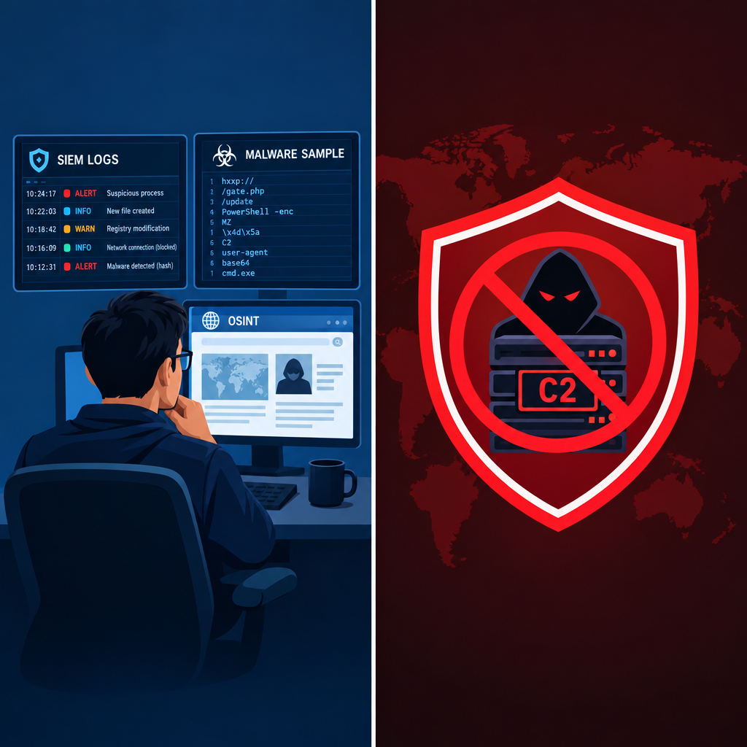
Passive Reconnaissance Defined
Passive recon: collect from existing sources
No direct interaction with target systems/networks
Sources: internal logs, IOCs, public OSINT
Benefit: low detection risk; quiet early mapping
Output: leads, not live confirmation

Slide 7
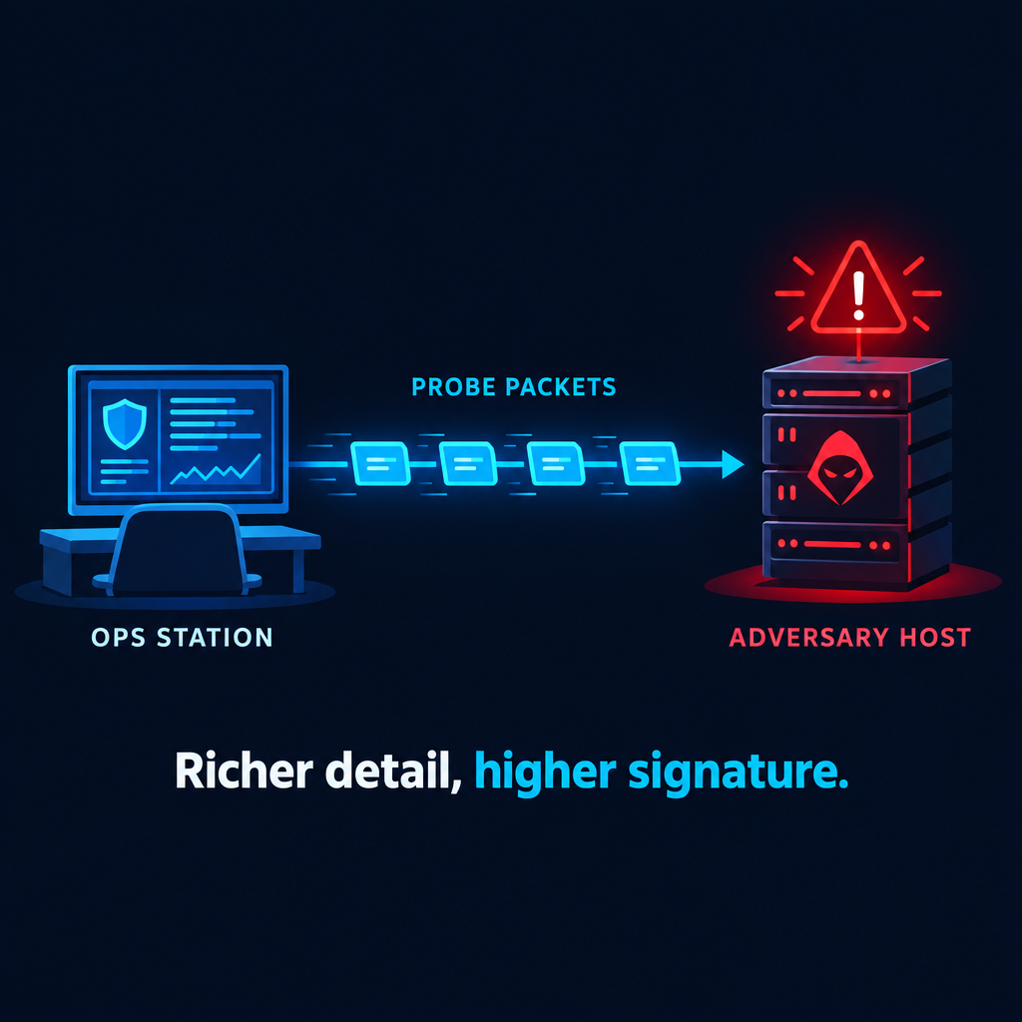
Active Reconnaissance Defined
Active recon: direct probing of adversary infrastructure
Examples: port scanning, vulnerability enumeration
Higher detection risk; richer live detail than passive alone
Reveals or verifies what observation could not
Feeds exploitation and effects planning

Slide 8
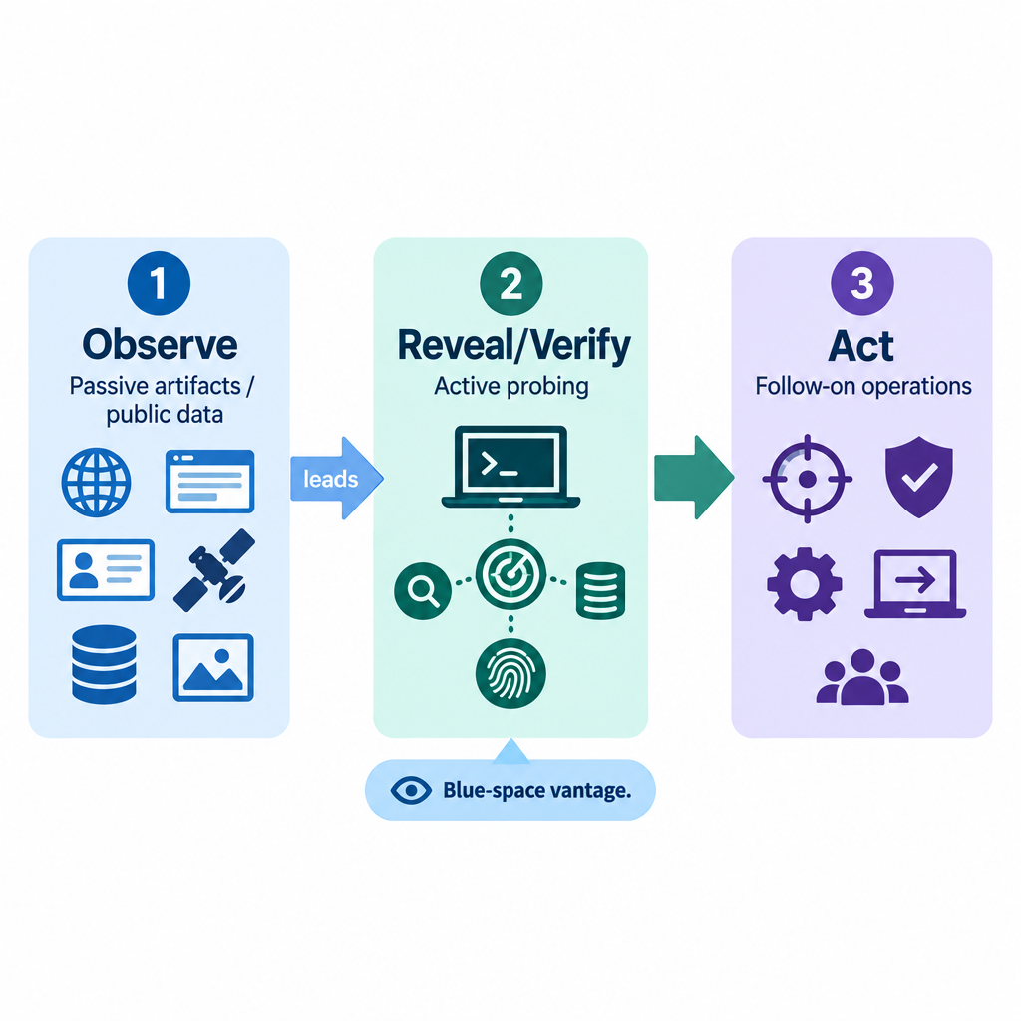
Passive vs Active — Distinctions
Passive: observational; points you toward leads from artifacts and public data
Active: interventional; verifies those leads or reveals what passive could not
Sequence: observe → reveal/verify → act
Blue-space edge: controlled vantage; probes can blend with expected traffic

Slide 9
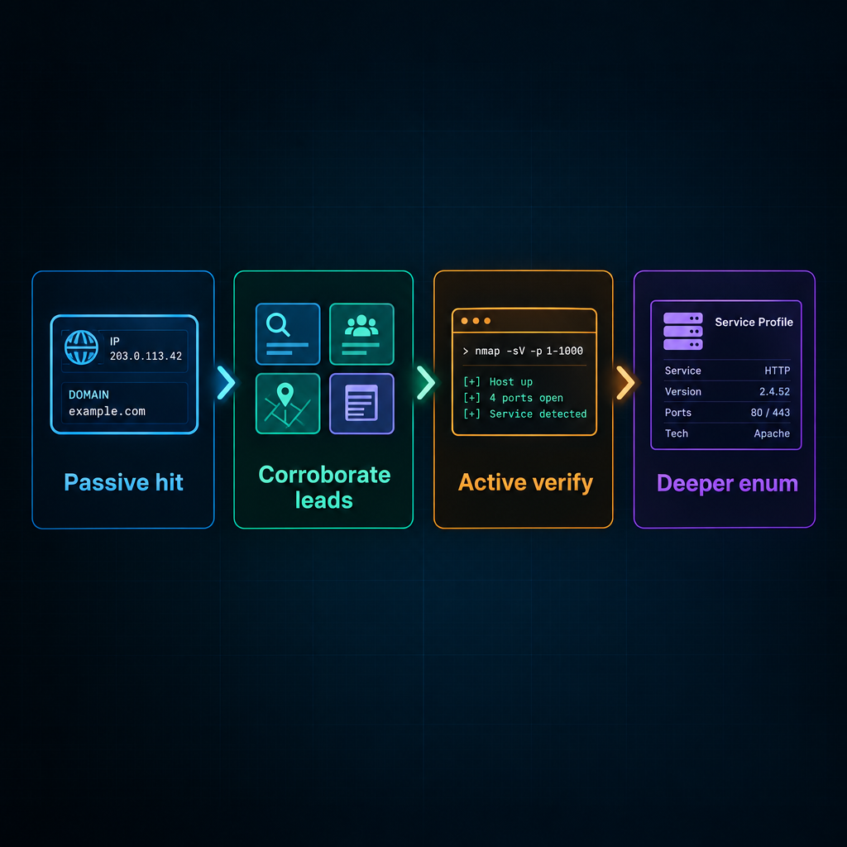
When to Go Active
Passive collection produced relevant leads
Need to reveal or verify live services for the next decision
Timing: after correlating passive evidence, then verify and enumerate
OSINT builds the lead picture; scanning verifies live services
Lecture weighting: passive = orientation; active = primary skill

Slide 10

Passive Reconnaissance

Slide 11
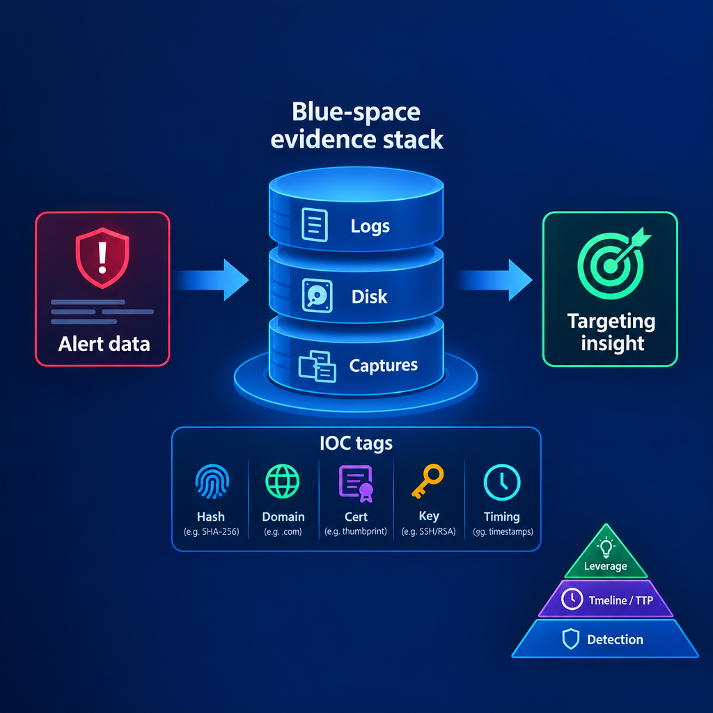
Mine What They Already Left
Start with IOCs and artifacts the adversary already left behind
Brief reminder: IOCs are traces (IPs, domains, hashes, keys, patterns)
Mine them without generating new traffic toward the adversary
Shift: same alert data → operations insight (timelines, leverage, weakness)

Slide 12
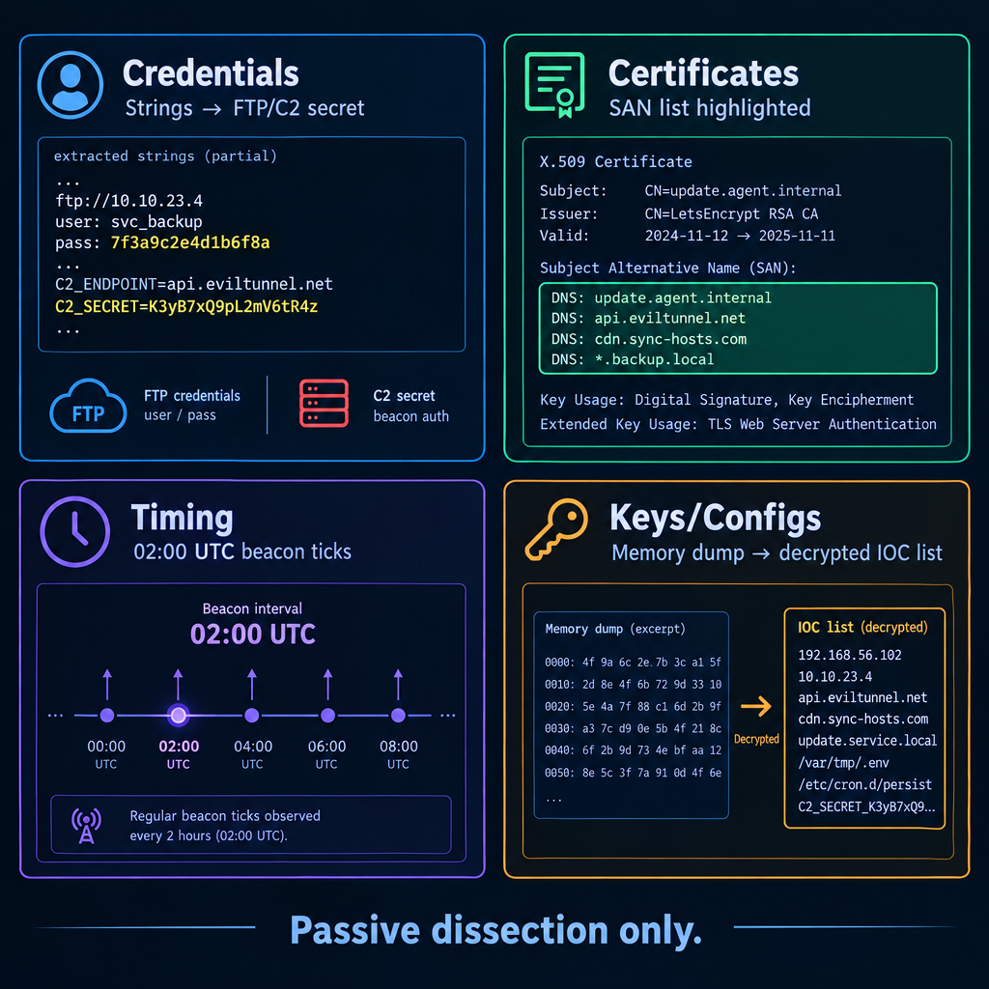
High-Value Artifact Classes
Credentials: embedded C2 keys, staging logins—strings on samples you already hold
Certificates: SANs and mismatched/expired TLS material in captures and logs
Timing: beacon intervals and login windows in SIEM timelines
Keys / configs: memory, registry, temp files that unlock more IOCs

Slide 13
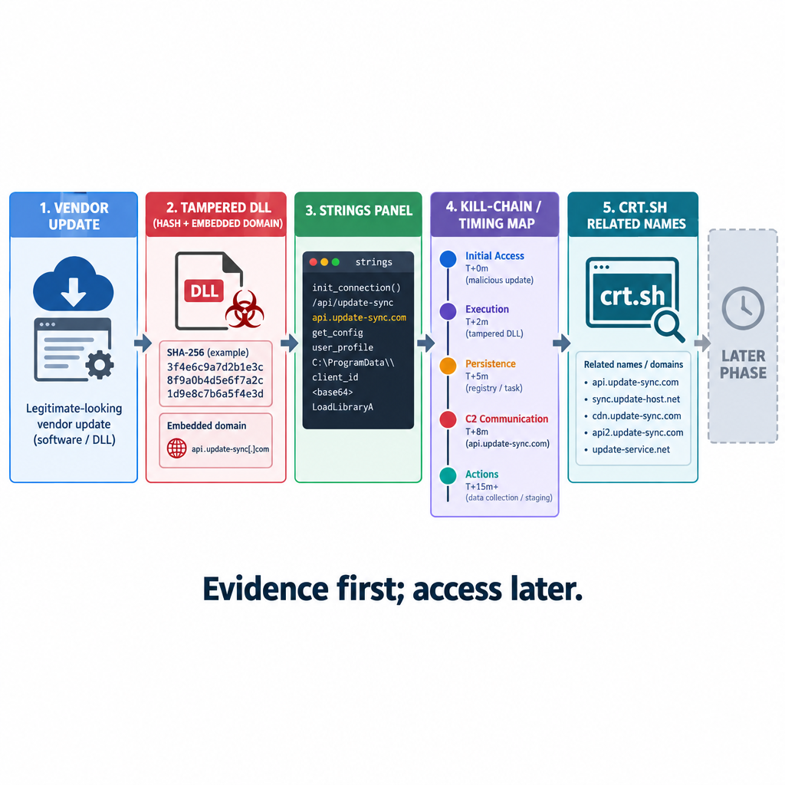
Case Study — SolarWinds (Passive Path)
Seed: tampered DLL hashes and embedded domains (public reporting)
Strings → C2 names, user agents, staged-update timing
Expand passively via certificate transparency (e.g., crt.sh)
Lesson: the same IOC pile can drive offensive intelligence

Slide 14
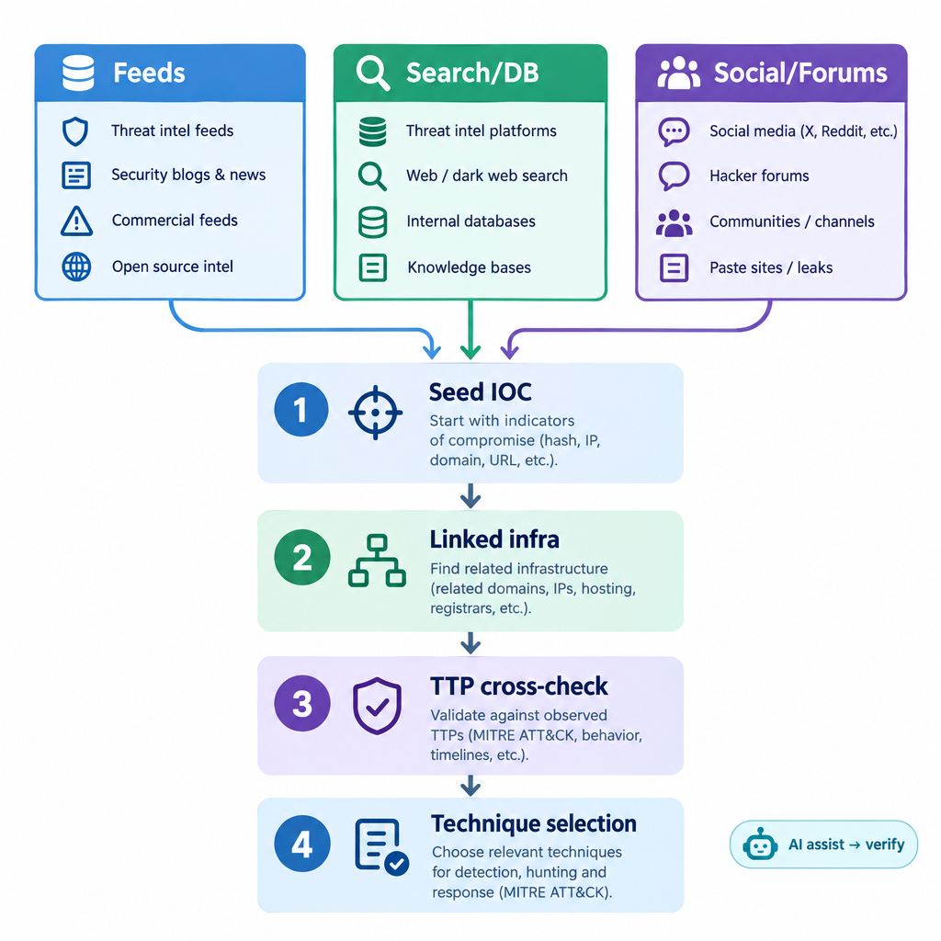
OSINT for Targeting and TTP Development
Public data maps adversary infrastructure and TTPs
Source families: intel feeds; search/DB (Google, Shodan/Censys on known IOCs); paste/social
Process: seed IOC → linked infra → report TTP cross-check → technique fit
SI assistants accelerate research—verify every SI-sourced lead

Slide 15
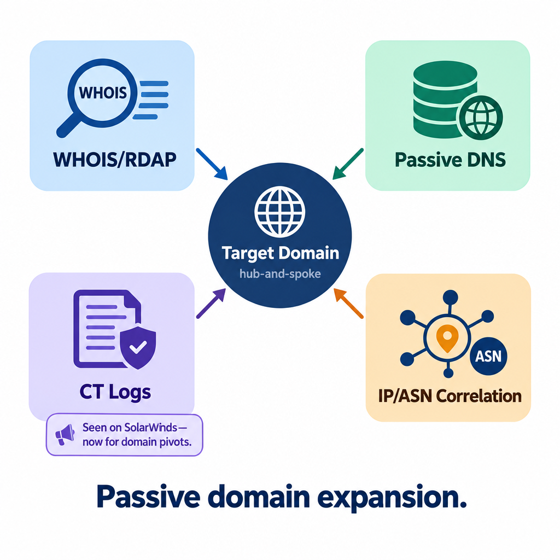
Domain Expansion Tools
Domains are often the hub (phishing, C2)
WHOIS / RDAP: registrant and shared-org clues
Passive DNS: historical records and subdomains
Certificate transparency: crt.sh for related names (same CT idea as the case study—now for domain pivots)
Correlation: shared IPs / ASNs via analyzers and reporting

Slide 16
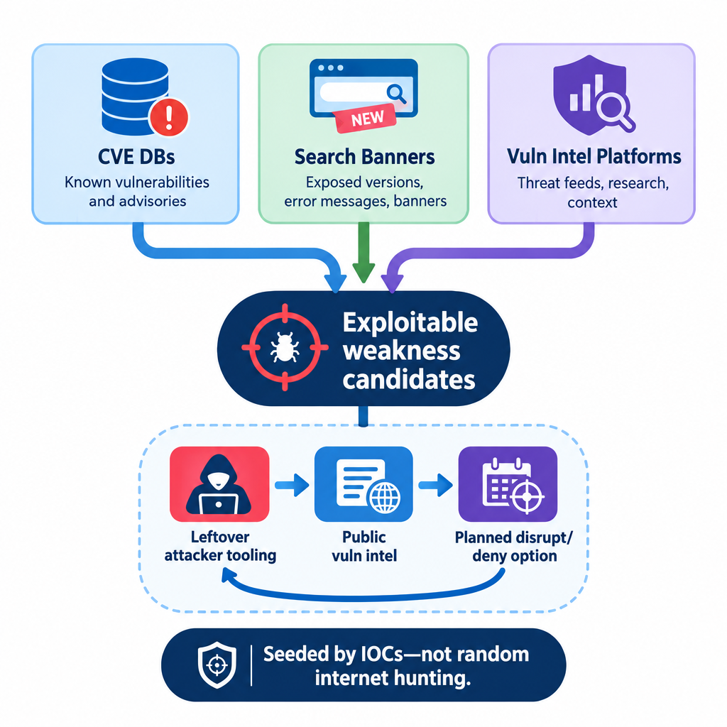
Passive Vulnerability Intelligence
IOC-seeded public data on exposed adversary services—not a scan you launch
CVE / Exploit-DB keyed by versions from fingerprints you already have
Shodan-class banners on known attacker domains/IPs
Output: candidate weaknesses for planning, including later disruption options

Slide 17
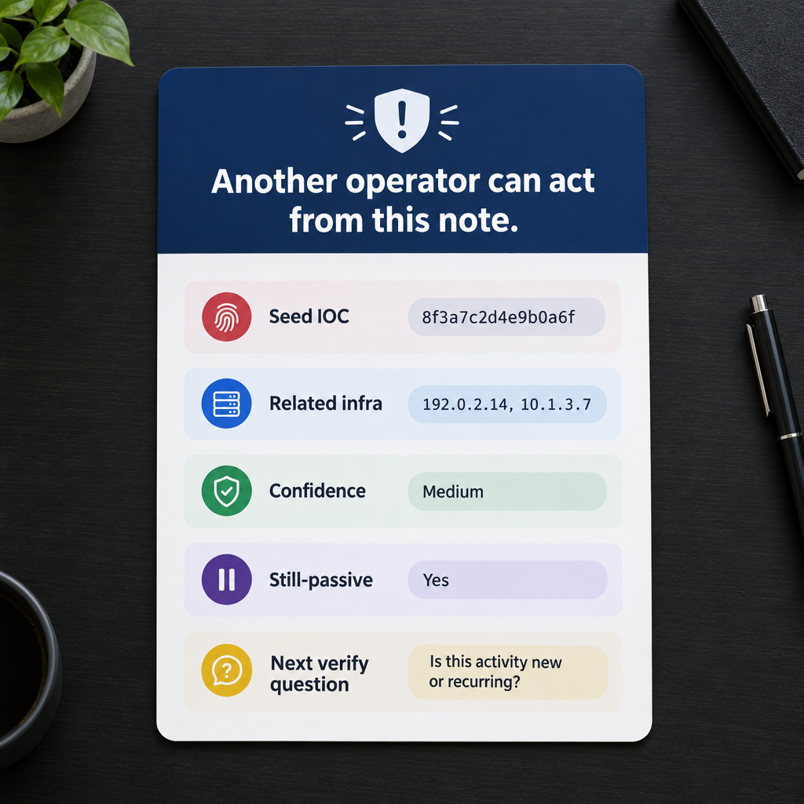
Passive Product — A Lead Package
Infra sketch, related names/IPs, confidence, still-passive status
OSINT is noisy and can be stale—validate across sources
Handoff question: what must active recon reveal or verify next?
This hour now moves from the lead picture to probing

Slide 18

Active Reconnaissance

Slide 19

Mutual Hunt and Cost vs Gain
Adversary defenders may hunt your probes the way you hunt scans
Targets log attempts; IDS/IPS and SIEM can correlate patterns
Mitigate: stealth pacing, traffic mimicry, disciplined scope
Weigh detection cost against intelligence gain that changes a decision

Slide 20
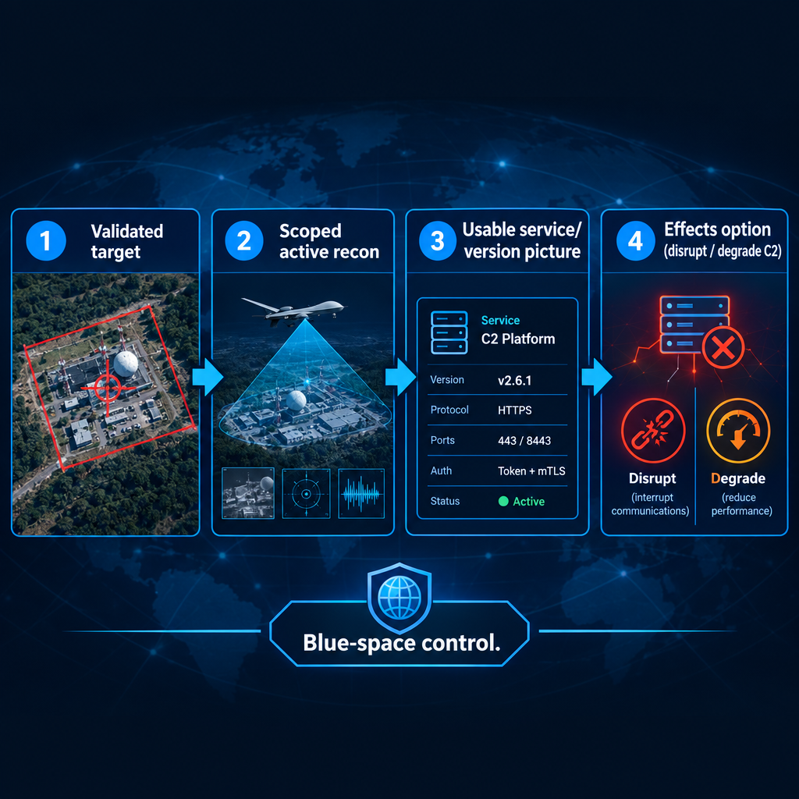
Execution Standard for Active Recon
Validate the target before probes; align collection to campaign objectives
Blue-space advantages: visibility and control; hit covert assets without self-compromise
Goal: precise recon that enables effects (e.g., disrupt C2)
Execution discipline beats volume scanning

Slide 21
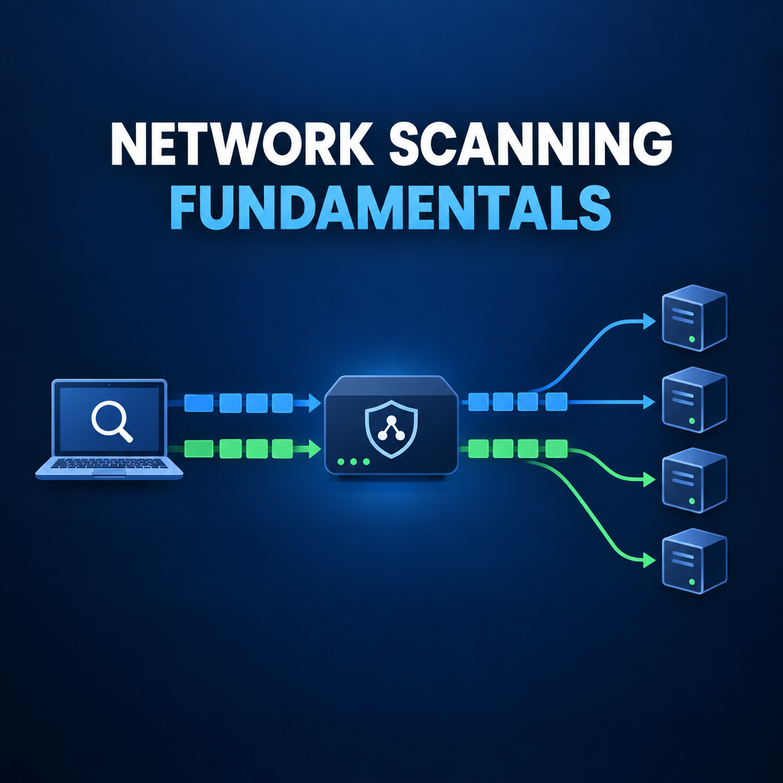
Network Scanning Fundamentals

Slide 22
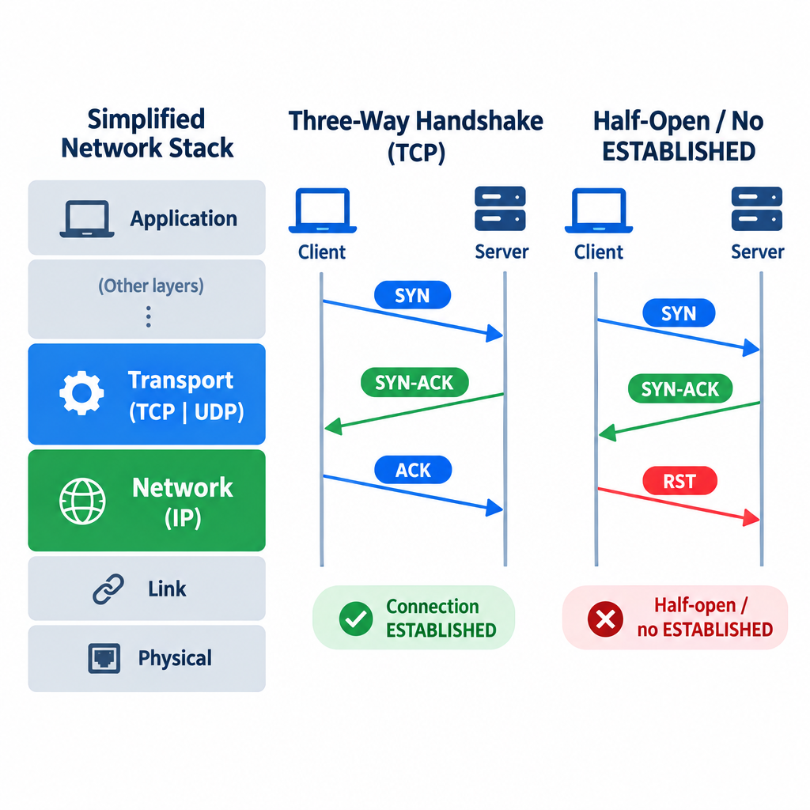
TCP/IP, Handshake, and Scan States
Focus layers: Network (IP) and Transport (TCP/UDP)
Handshake: SYN → SYN-ACK → ACK (full connection / ESTABLISHED)
Half-open: SYN → SYN-ACK → RST—never ESTABLISHED
Counterops: TCP for reliable service intel; UDP for datagram-only services

Slide 23
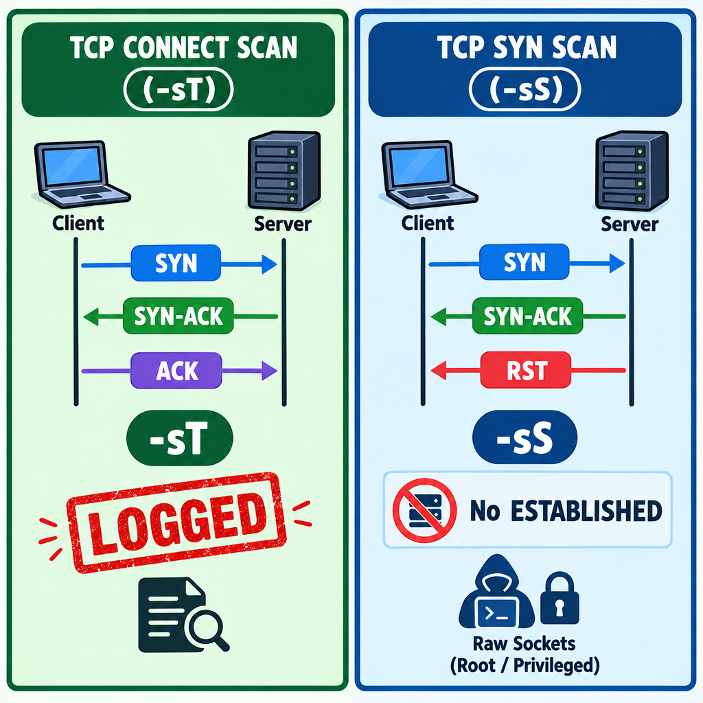
TCP Connect vs SYN Scan
Connect (`-sT`): full handshake—reliable, often through stateful firewalls, noisier logs
SYN (`-sS`): half-open—faster, less full-session logging, needs raw sockets
Default preference: SYN when privileges allow
Use connect when thoroughness beats stealth on a high-value node

Slide 24
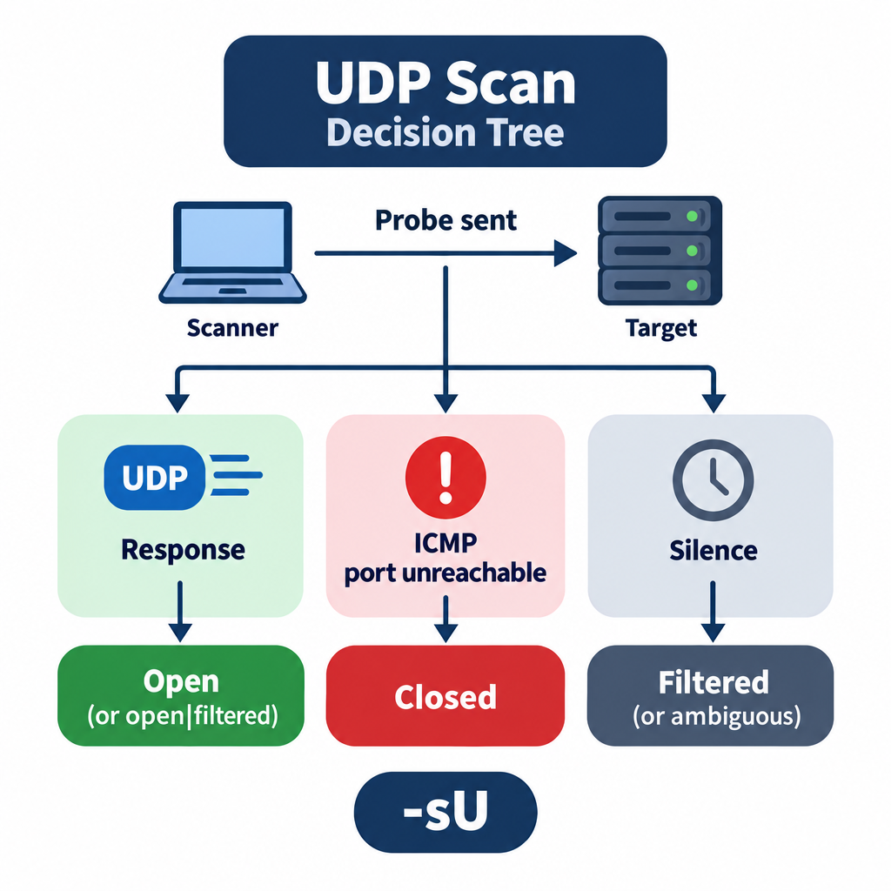
UDP Scan
Send UDP; open may respond or stay silent; closed often → ICMP unreachable
Finds UDP services (DNS, some C2 / management) that TCP sweeps miss
Slow, rate-limited, and often open|filtered—treat silence as ambiguous
Follow ambiguous results with protocol-aware probes, not blind trust

Slide 25
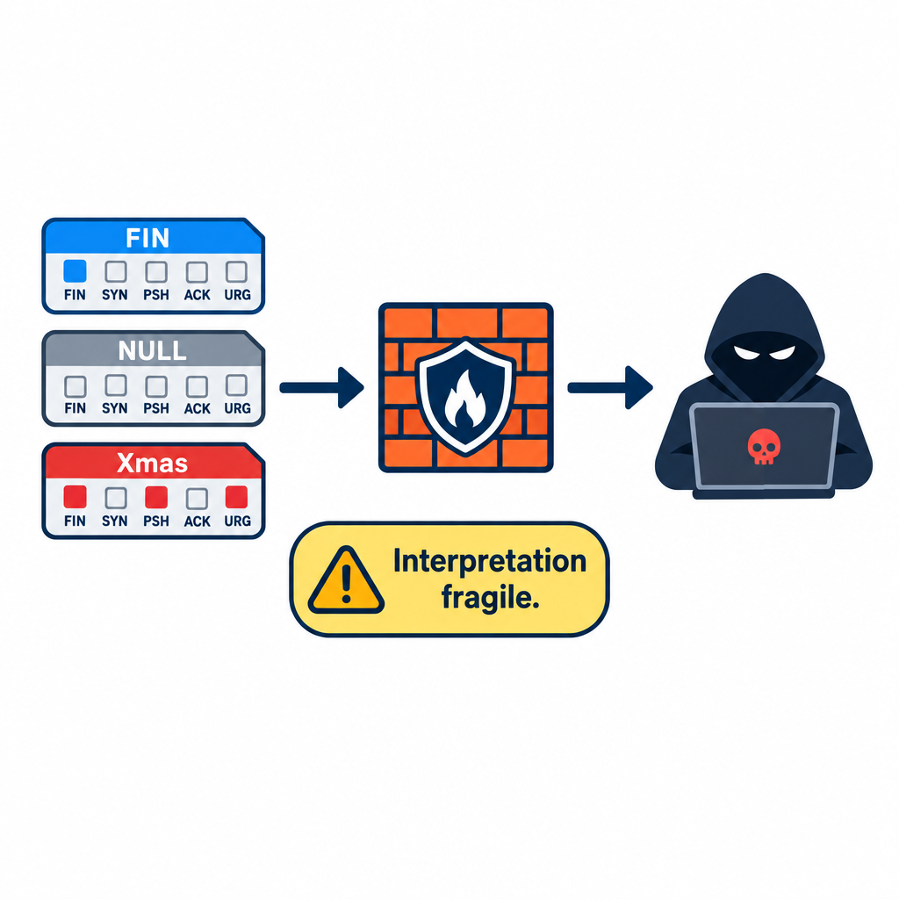
FIN, NULL, and Xmas Scans
FIN / NULL / Xmas: unexpected TCP flag combinations
Can slip simple filters; modern stacks often break textbook assumptions
Use against heavily filtered covert infra—verify results carefully
Prefer SYN when you need a reliable open/closed call

Slide 26
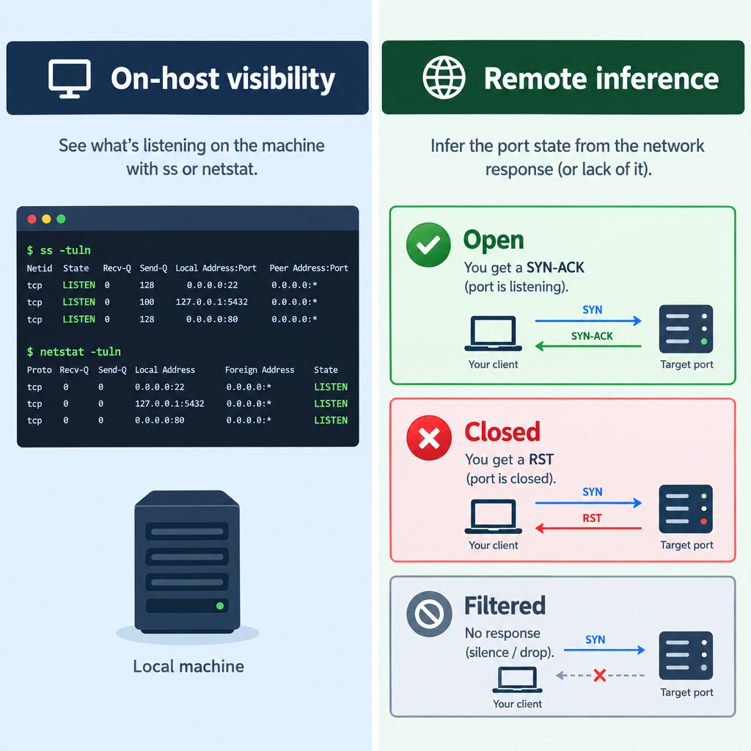
Port States — Open, Closed, Filtered
On-host (blue space): query listeners directly (ss / netstat)
Remote scan: infer state from packet responses only
Open: SYN-ACK—candidate surface
Closed: RST / unreachable—no service
Filtered: no useful response—do not treat as empty

Slide 27
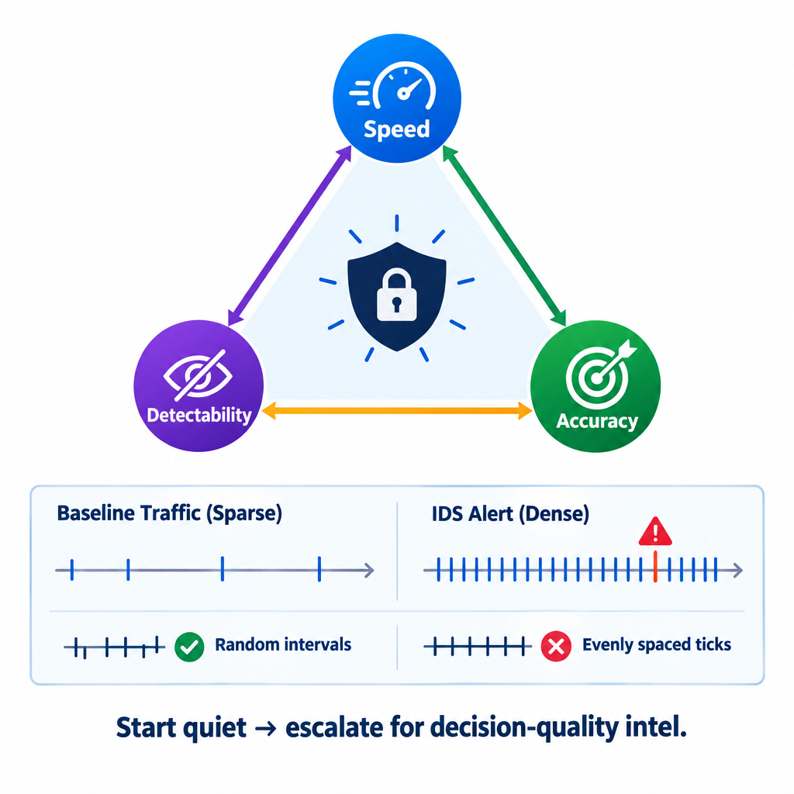
Timing — Speed, Detectability, Accuracy
Aggressive rate → fast intel, lights up IDS; slow spacing → quieter, longer
Three knobs: speed, detectability, accuracy
Start quiet from blue vantage; escalate only when the decision needs it
Randomize intervals; align with the operational environment—avoid a metronome

Slide 28
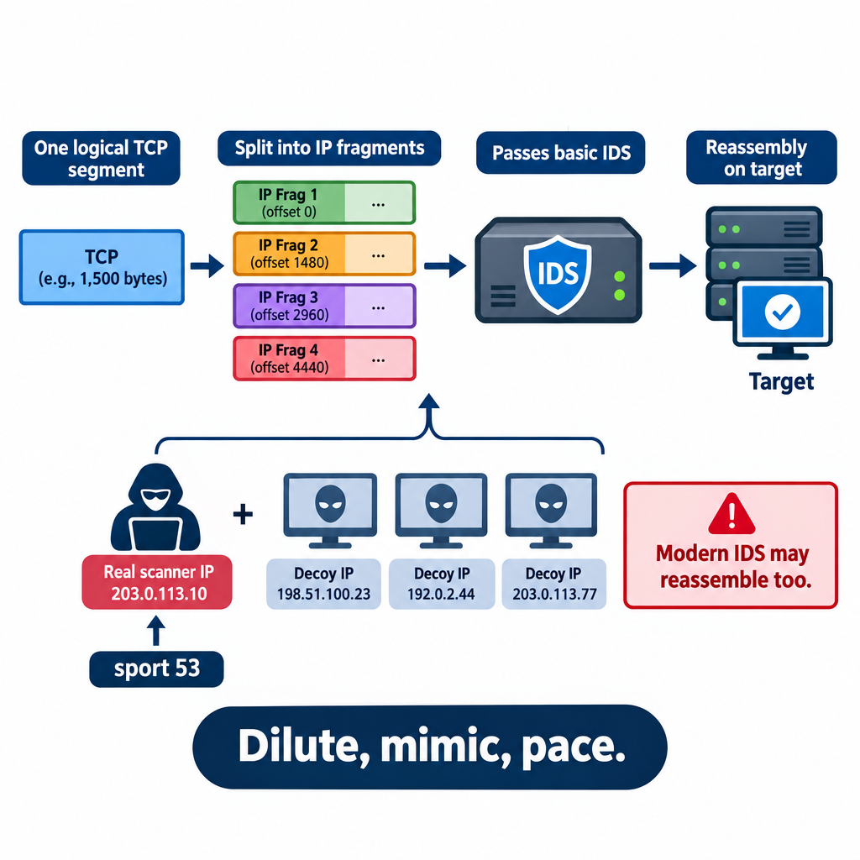
Evasion — Fragments, Decoys, Source Ports
Fragmentation: split PDUs so weak filters miss signatures; modern IDS may reassemble
Decoys: extra source IPs to dilute attribution
Source port tricks: common ports (e.g., 53) to mimic legit flows
None of these erase scope—they reduce easy matches

Slide 29

Nmap Deep Dive

Slide 30
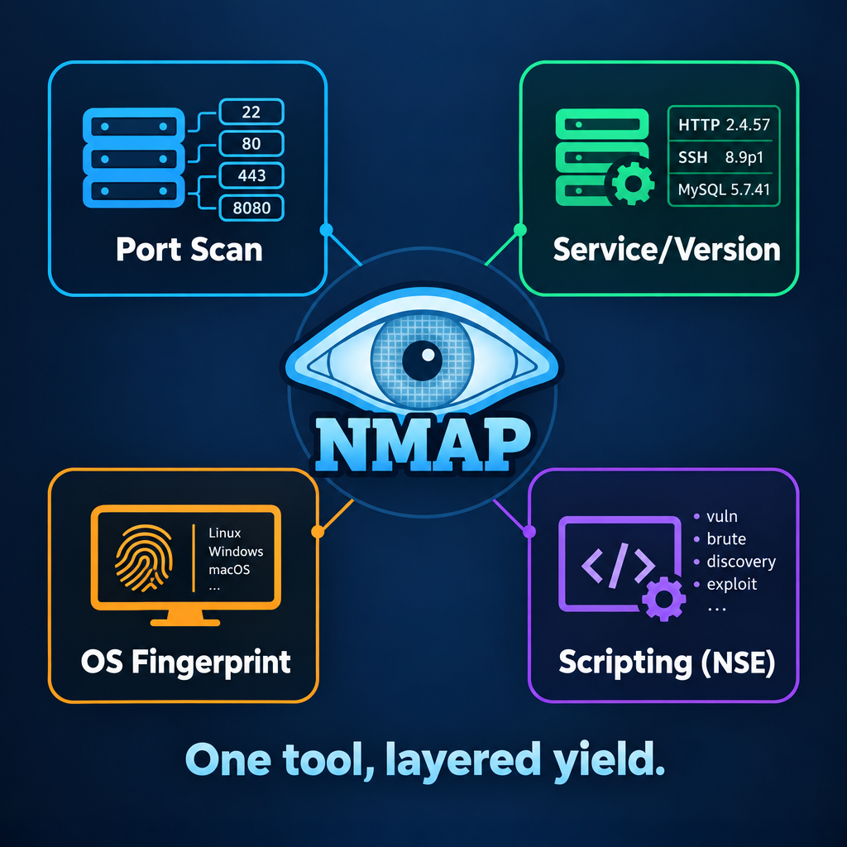
Nmap as a Collection Platform
Nmap: open-source scanner for host and network discovery
Core capabilities: ports, service/version, OS fingerprint, NSE scripts
Treat every flag as a yield-versus-visibility choice
Primary active collection tool for this hour

Slide 31
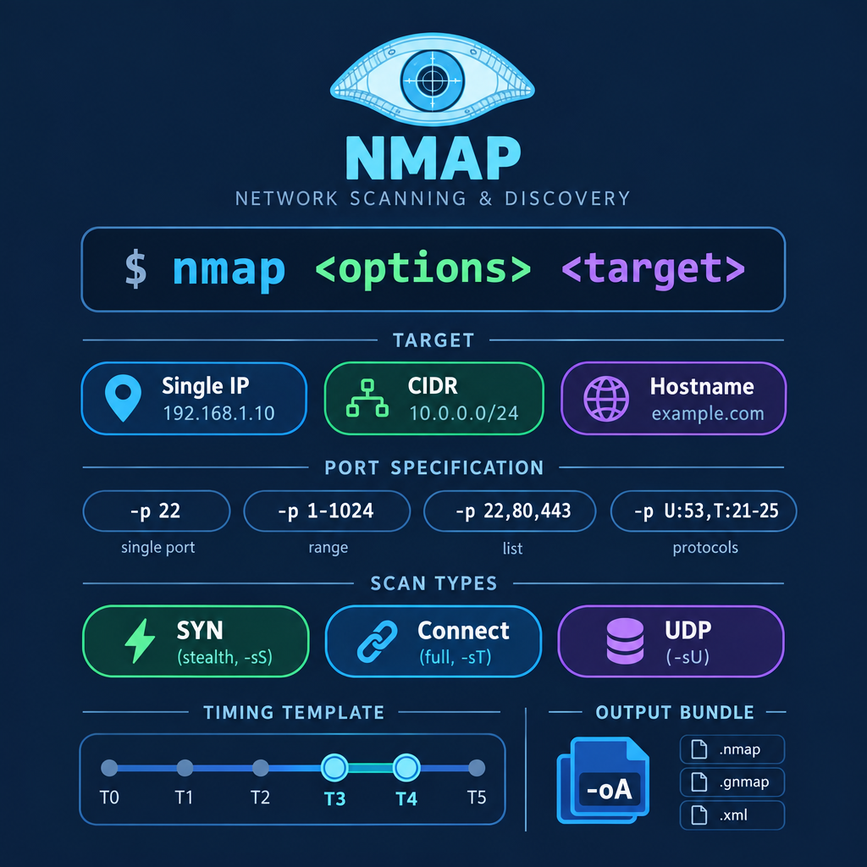
Scope, Ports, Scan Types, Timing, Archive
Target: single host, CIDR, or name—size scope to the intelligence need
Ports: -p 22,80 focused; -p- full TCP
Types: -sS SYN; -sT connect; -sU UDP
Timing: -T0 … -T5; prefer T3–T4 for most recon
Output: -oA so you do not rescan to recover notes

Slide 32
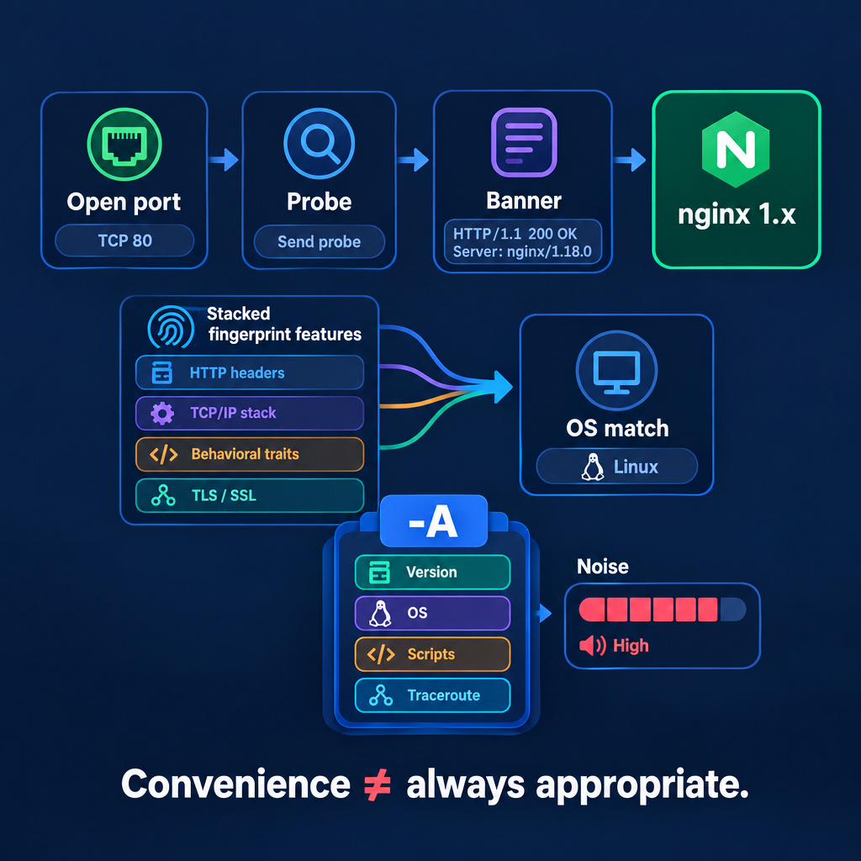
Versions, OS Fingerprint, and -A
`-sV`: protocol probes → banners → name and version for CVE matching
`-O`: stack quirks vs nmap-os-db—worth it on high-value nodes
`-A`: bundles -sV, -O, script scan, traceroute—high yield, high volume
Stage collection: ports first; deepen where the profile justifies noise

Slide 33
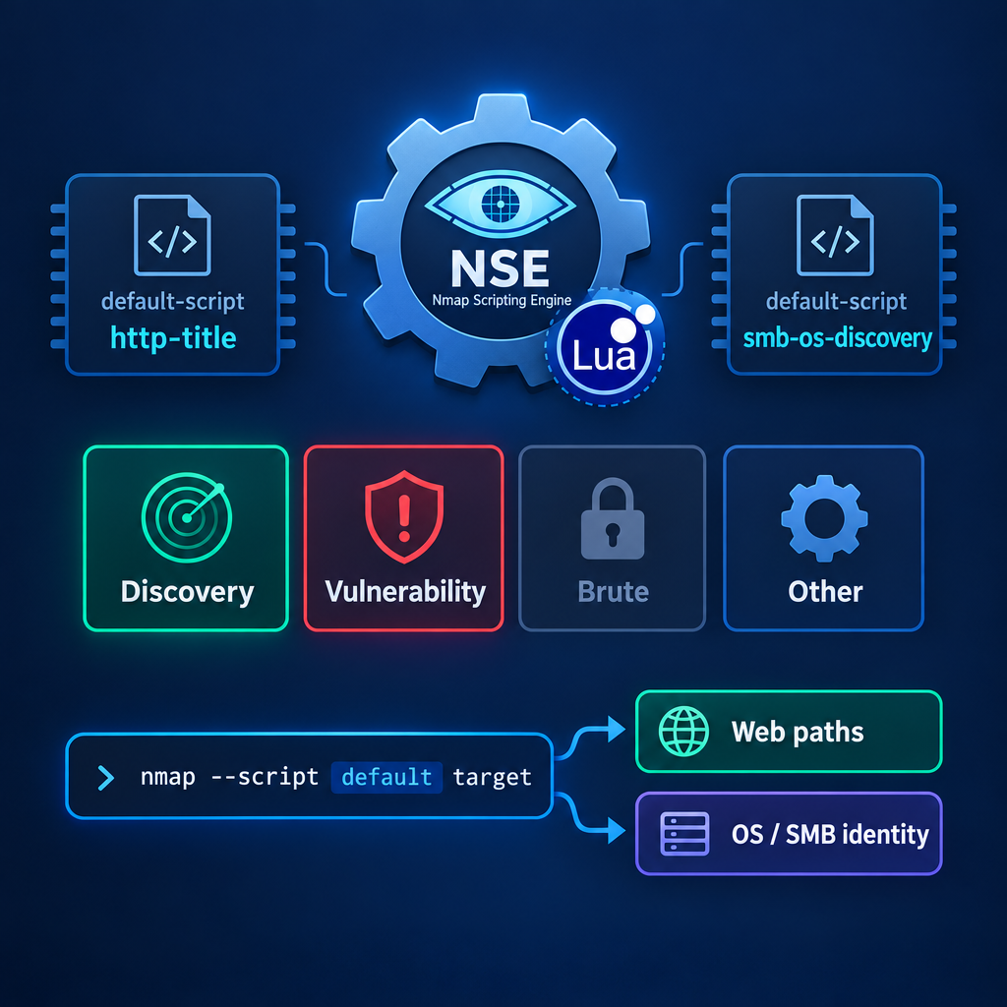
NSE — Defaults, Categories, and Recon Scripts
`-sC`: default script set—common enumeration after open ports
`--script`: categories or names (discovery, vuln, http-enum)
Lead with discovery and vulnerability; brute only when planned
Example: nmap --script http-enum,smb-os-discovery -p 80,445 target

Slide 34
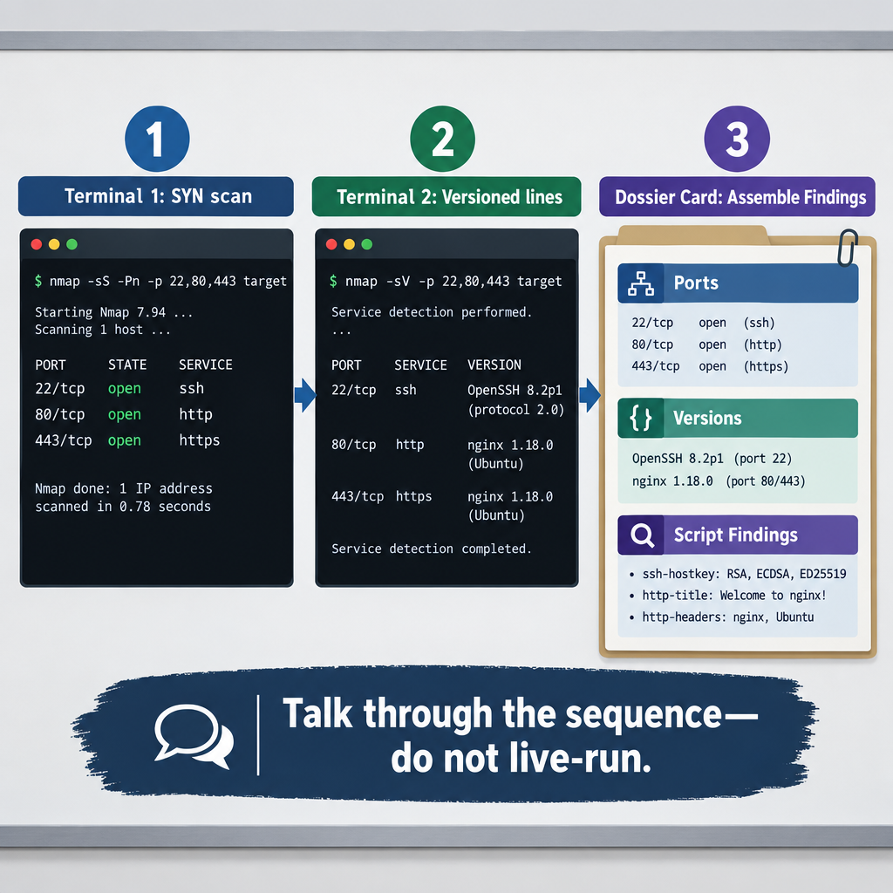
Example — Ports, Versions, Profile
Example sequence: nmap -sS -p- target → candidate listeners
Then: nmap -sV -p 22,80,443 target → name and version
Then: nmap -sC -sV target → enum details on top of banners
Save output; unknown remaining work is part of the profile

Slide 35
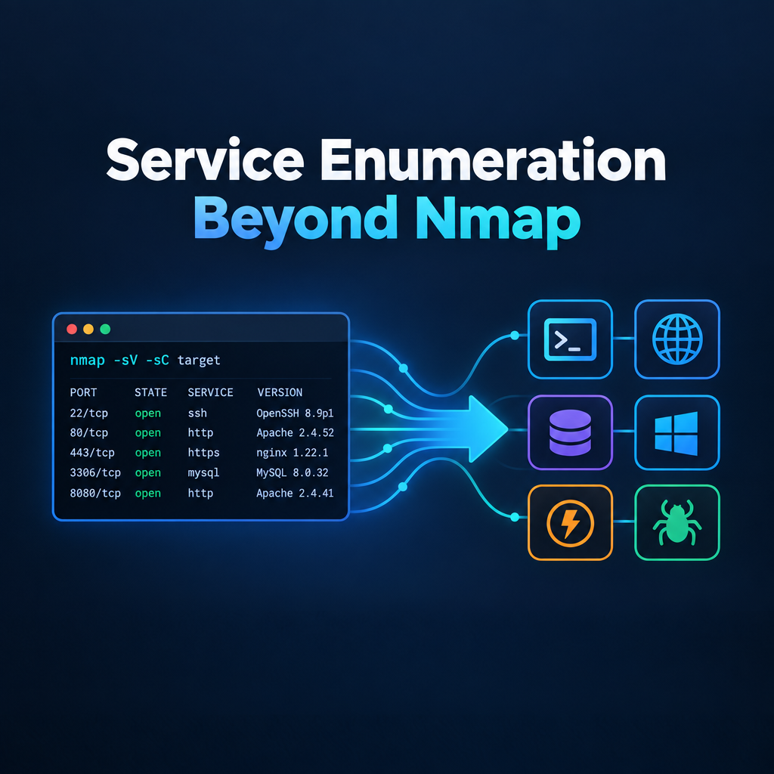
Service Enumeration Beyond Nmap

Slide 36
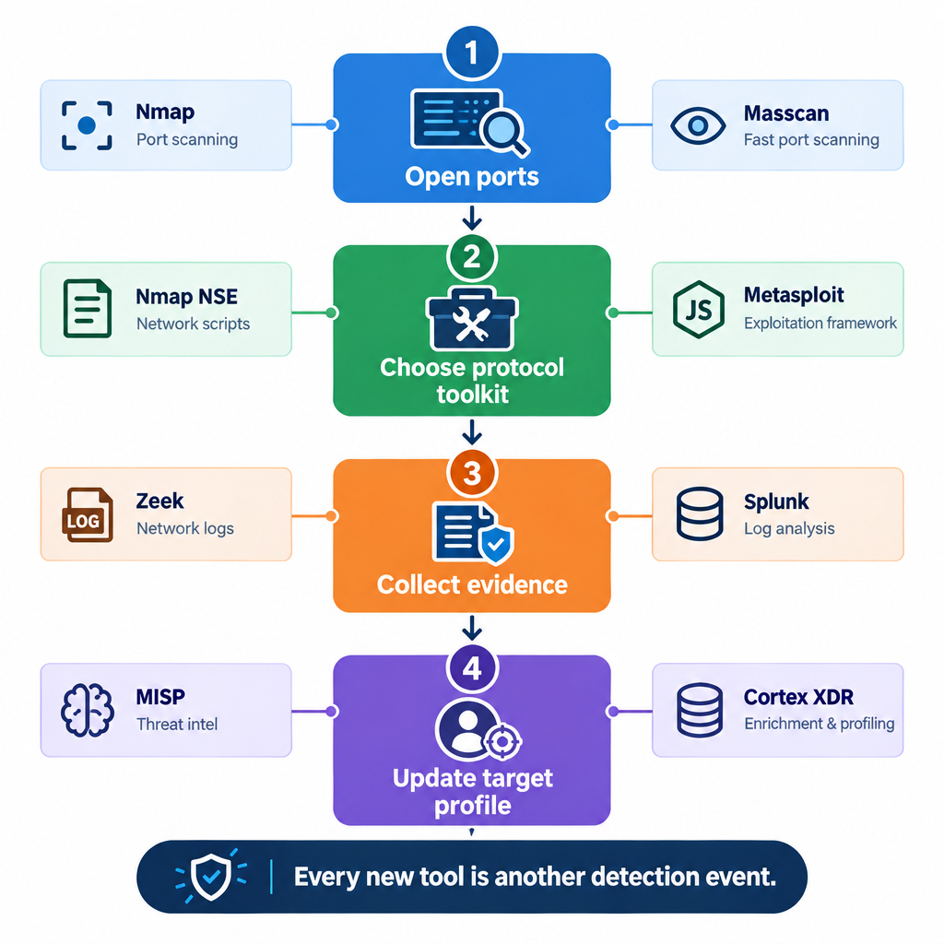
Protocol-Specific Enumeration
HTTP/HTTPS: WhatWeb (stack), Nikto (issues), gobuster (paths)
SMB (445): enum4linux, smbclient, smbmap
SNMP (UDP 161): snmpwalk / snmp-check—often missed by TCP-only scans
DNS: AXFR and record enum → names that IP scans never show
Banners: nc/telnet on FTP/SSH; RDP with care

Slide 37
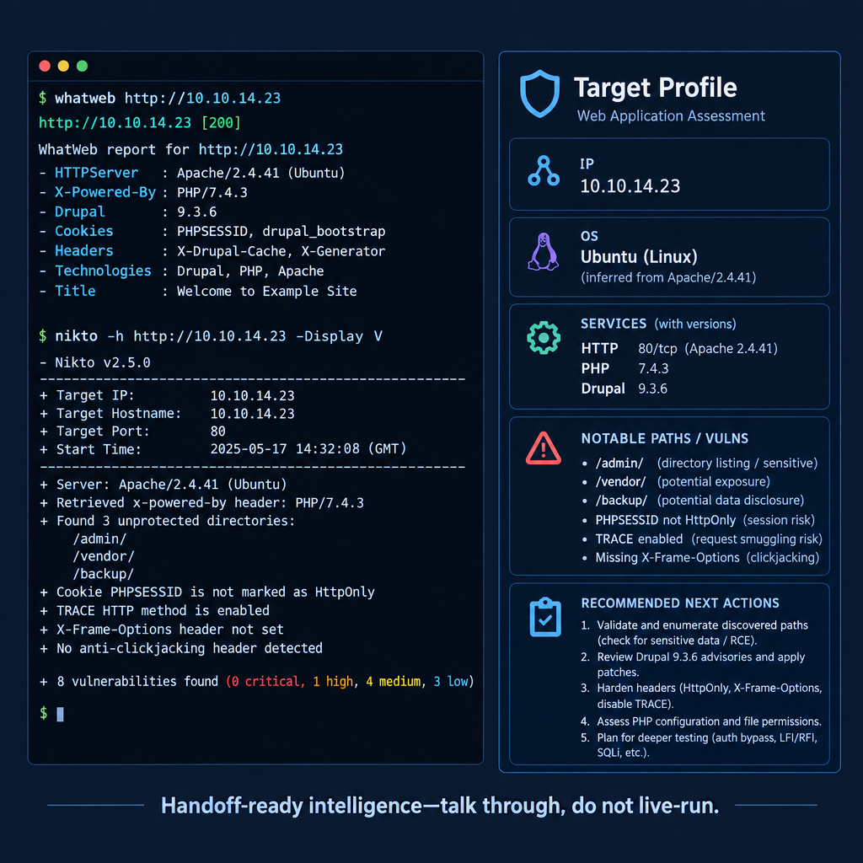
Example — HTTP Enum and the Target Profile
Example: whatweb target; nikto -h target on an open web listener
Compile: ports → services → versions → paths / vuln candidates
Example profile: Linux; aged SSH; Apache with /admin
A usable profile is more than open ports on screen

Slide 38

OPSEC and Detection Considerations

Slide 39
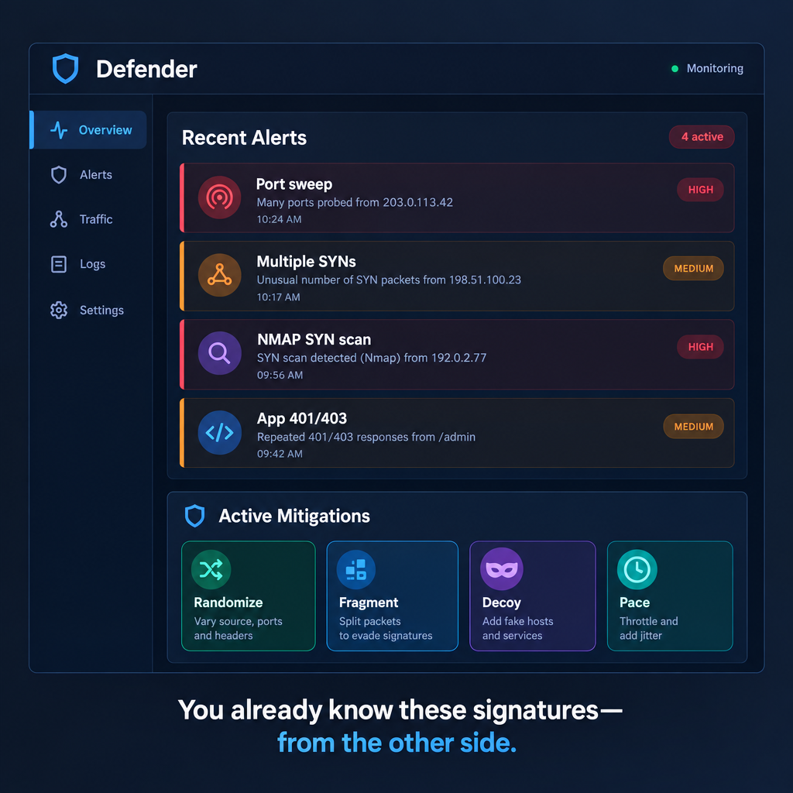
How the Scan Looks to Their Defenders
Same patterns you hunt in blue space: SYN volume, sequential probes, odd sources
Firewall drops, IDS signatures (including Nmap patterns), app logs, SIEM correlation
Filtered is still intelligence—perimeter behavior is a finding
Mitigate: randomize timing/sources; fragment; decoys—on a justified scan

Slide 40
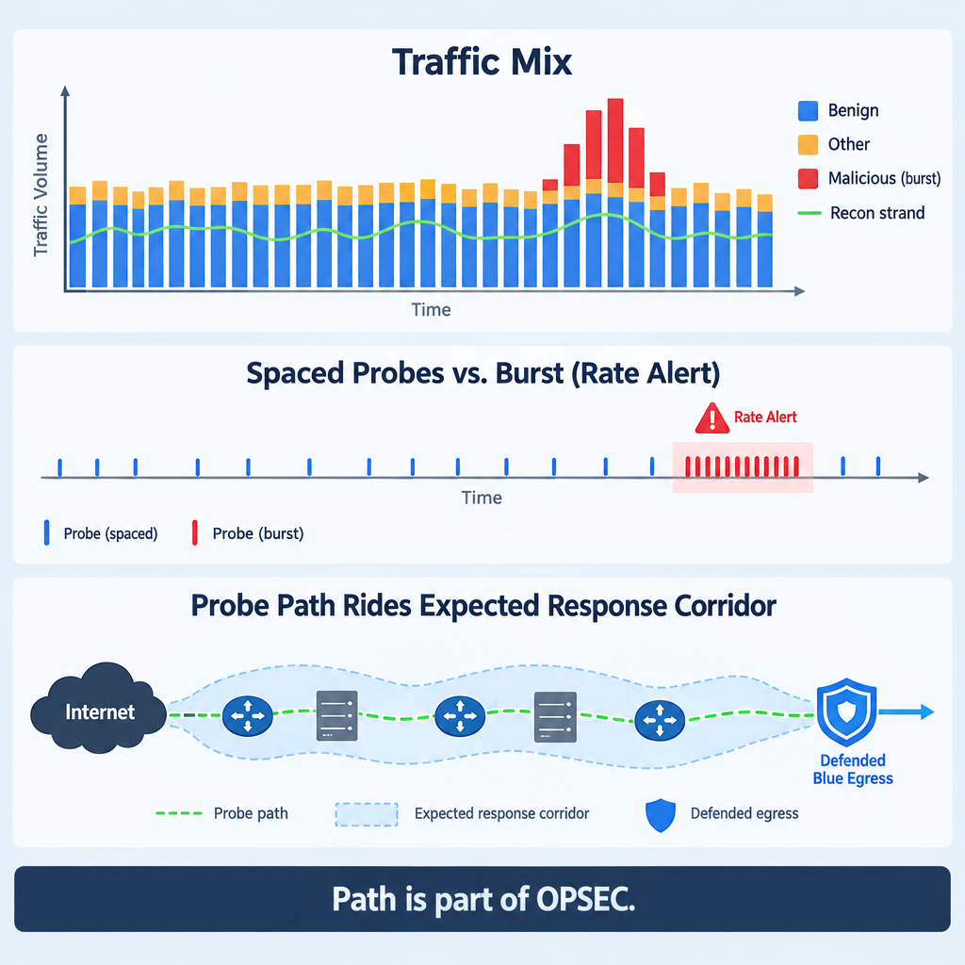
Blend, Pace, and Operational Infrastructure
Mimic expected user-agents and common source ports when tools allow
Distribute probes over time and multiple egress IPs
Pace: intervals and volume caps; T0–T2 when stealth outweighs speed
Emit from blue-space paths the adversary already expects

Slide 41
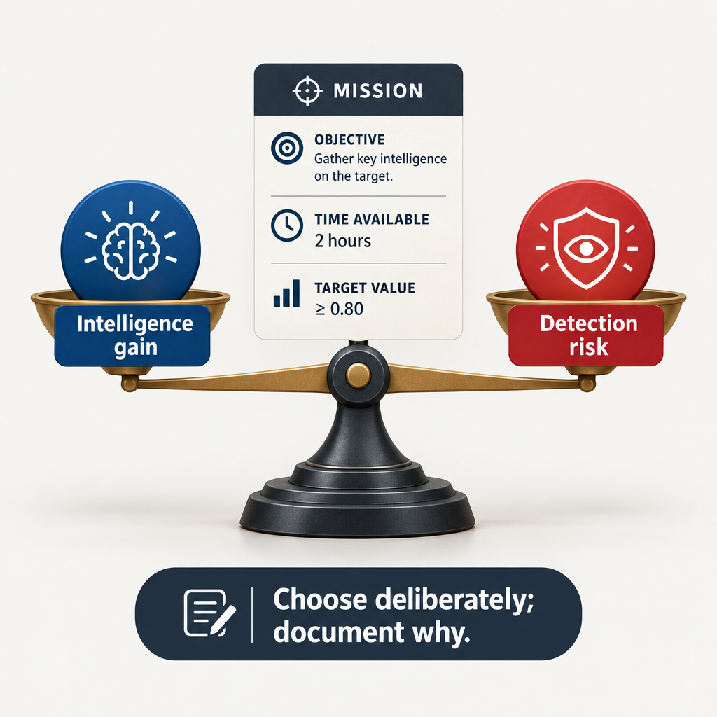
Document the Noise You Accepted
High risk: aggressive scans → faster vulns, louder alerts
Low risk: slower / passive follow-up → thinner confirmation
Decide per mission: effects need vs footprint cost
Write the rationale in the profile so the next operator understands it

Slide 42
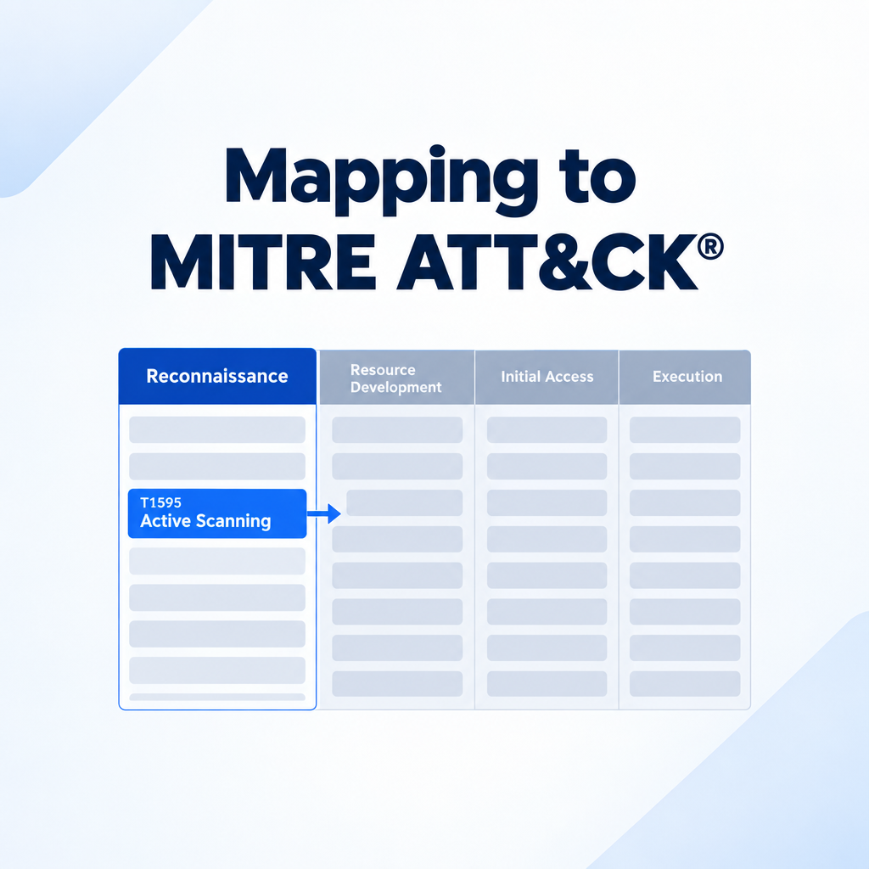
Mapping to MITRE ATT&CK®

Slide 43
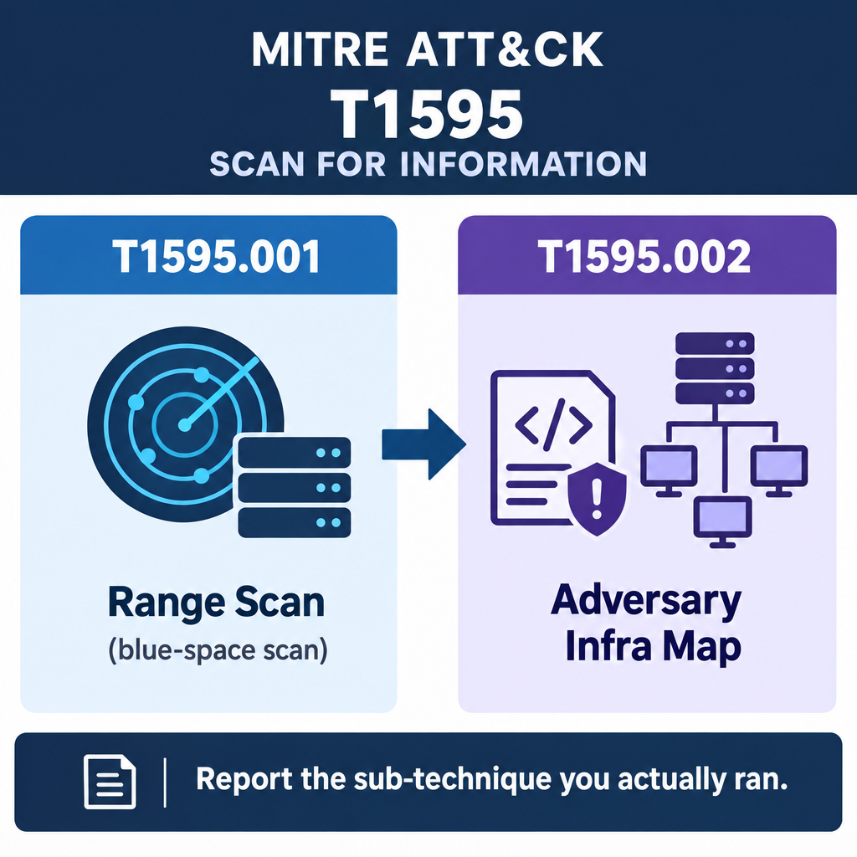
T1595 — Active Scanning
Technique T1595 Active Scanning under TA0043
Flip the technique: scan their infrastructure for counterops
T1595.001 Scanning IP Blocks — CIDR / range sweeps
T1595.002 Vulnerability Scanning — -sV and vuln-oriented scripts
Report the sub-technique you actually ran

Slide 44
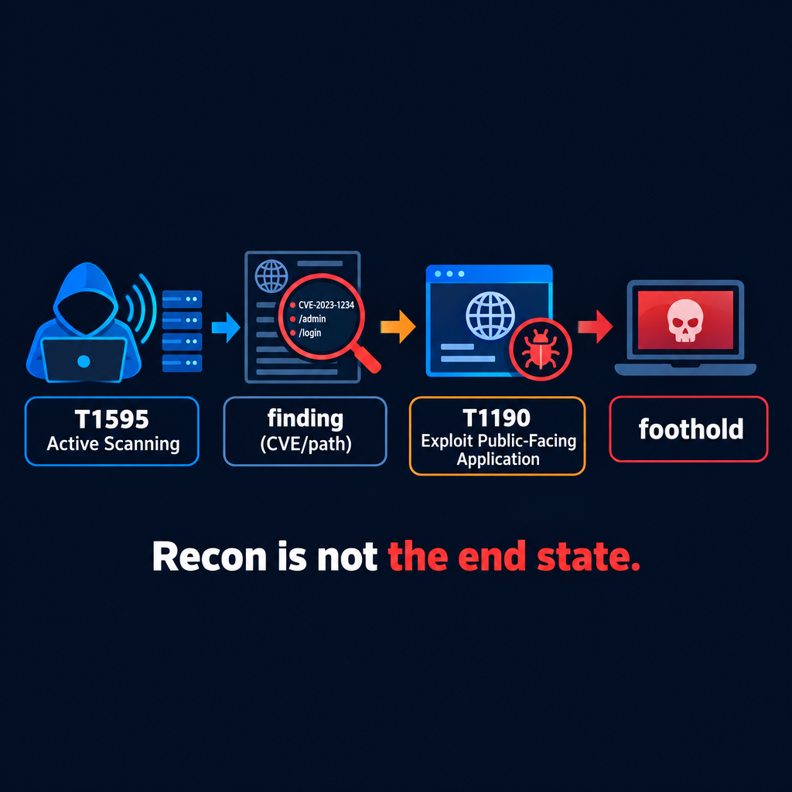
Recon Feeds Initial Access
Active recon → TA0001 Initial Access
Example path: scan finds vuln → T1190 exploit public-facing app
Campaign: recon yield becomes the effects-chain input
Own the quality of the recon handoff; access comes later

Slide 45
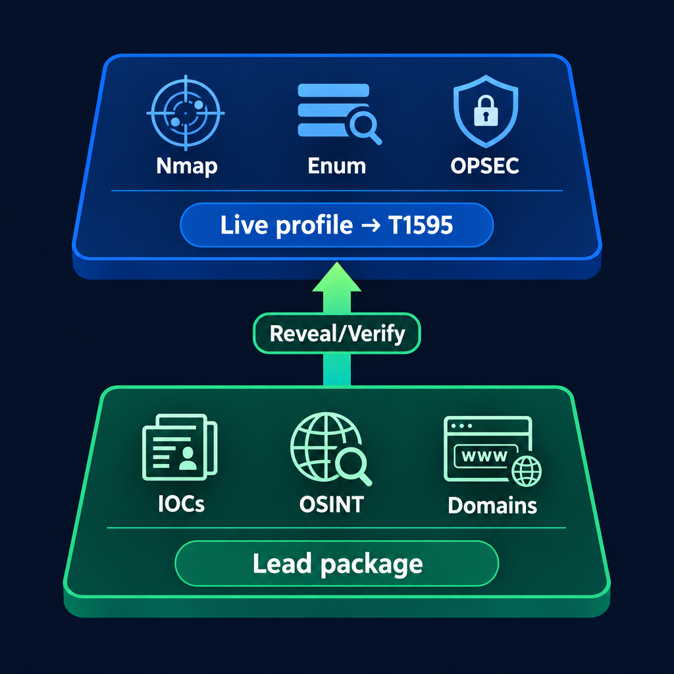
Lesson Summary
Recon as a whole: reconnoiter / TA0043 against adversary infra from blue space
Passive = observe → leads; active = reveal/verify → live profile
Sequence: observe → reveal/verify → act
Building blocks: artifacts/OSINT for leads; Nmap/enum/OPSEC for confirmation
Report active scanning as T1595 (and the sub-technique you ran)

Slide 46
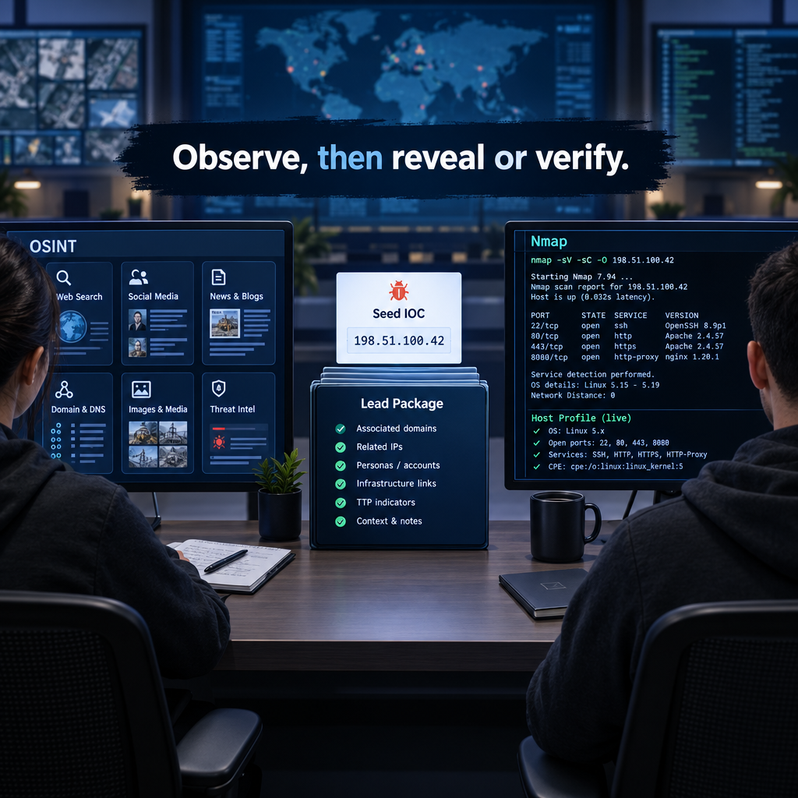
The Decision Loop You Leave With
OSINT: seed IOC → public pivots → lead package (passive)
Nmap: scoped scan → versions/scripts → handoff-ready profile (active)
Take today's sequence and OPSEC discipline onto the keyboard

Slide 47

Questions
Open floor
Leave with a lead package and a scan plan

Slide 48
Questions?

